Slide 1


Illinois Rural Water Association – Compliance Assistance Program
Mary Reed, Compliance Assistance Specialist

Slide 2
Compliance Assistance Program
I am your part-time IRWA Compliance Assistance Specialist. Coming to you out of retirement from the Illinois EPA, where I was the previous manager of the drinking water compliance unit, and I am available to assist you with retaining and/or returning to compliance with state and federal rules and regulations relating to potable water.

Slide 3

Compliance Assistance Program
So, what exactly does that mean? I am normally available Monday thru Thursday in the morning to:
Assist with navigating Drinking Water Watch and the operator certification database
Assist with the development, preparation and submittal of periodic and routine compliance reports, such as CCRs, Public Notifications, Sampling forms, and Sample Site Changes
Review your Monitoring Schedule
Review correspondence prior to submission to the Illinois EPA
Provide reminders about deadlines for reporting

Slide 4
Compliance Assistance Program
IRWA is making this assistance available as a service to our members because we realize the complexity of regulatory compliance and how to calculate it. I look forward to providing this service to assist as an “insurance program” providing peace of mind, when you see that we can come to the same conclusion to resolve issues.

Slide 5
Compliance Assistance Program
Drinking Water Watch (DWW) is the window into the information that is held in the Illinois EPA’s Safe Drinking Water Information System (SDWIS)
If you look at DWW and something is not correct, then that means that it is also wrong at the Illinois EPA, and you should take action to get it corrected.
https://water.epa.state.il.us/dww/index.jsp

Slide 6
Drinking Water Watch
  DWW is also the place to review your monitoring schedule.
  By looking at your schedule you will see what monitoring is coming up for the current year.
  The trick is to know how to access and read the schedule

Slide 7
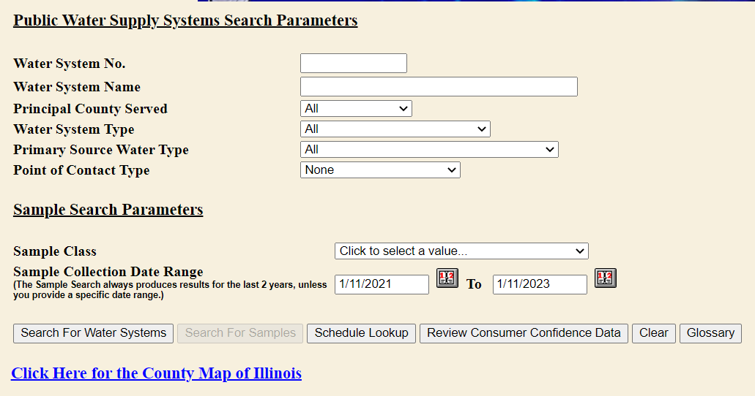
Drinking Water Watch

Slide 8
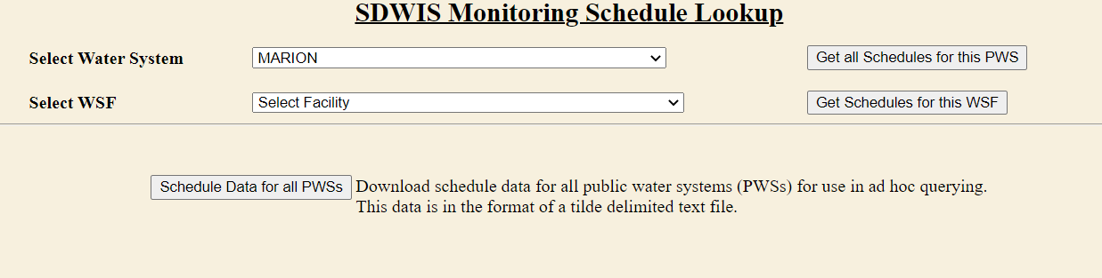
Drinking Water Watch
The schedule will be a PDF pop up, so you will need to have the Pop-Up Blocker turned OFF

Slide 9
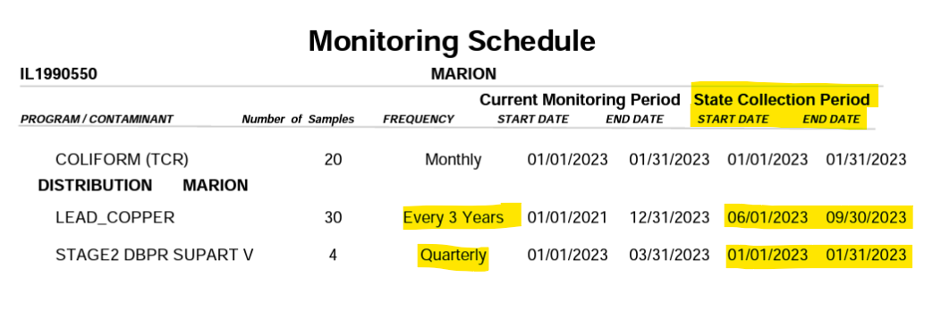
Drinking Water Watch

Slide 10
Drinking Water Watch
  In the example on the previous slide, Marion has lead and copper sampling due in 2023. Once monitoring has been completed, they will need to provide a copy of the result and some educational materials to each household that monitored for them.
        This must be done within 30 days of receiving the results and certified to the Illinois EPA within 3 months of the end of the monitoring period. (December 29)
        Submittals can be sent to EPA.leadandcopper@illinois.gov
    DBP samples are also due each quarter, however they must be collected in a specific month of the quarter, the schedule will tell you the month

Slide 11
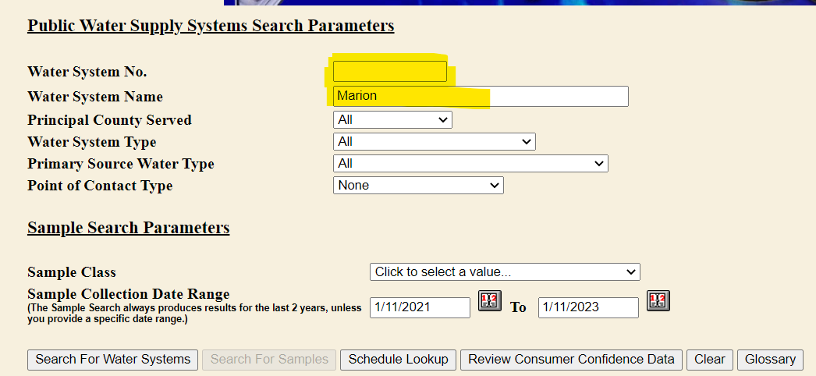
Drinking Water Watch
  Something else DWW can show you is if the laboratory has submitted your sample results to the Illinois EPA. The regulations require that each CWS submit sampling results within 10 days of the end of the monitoring period.

Slide 12
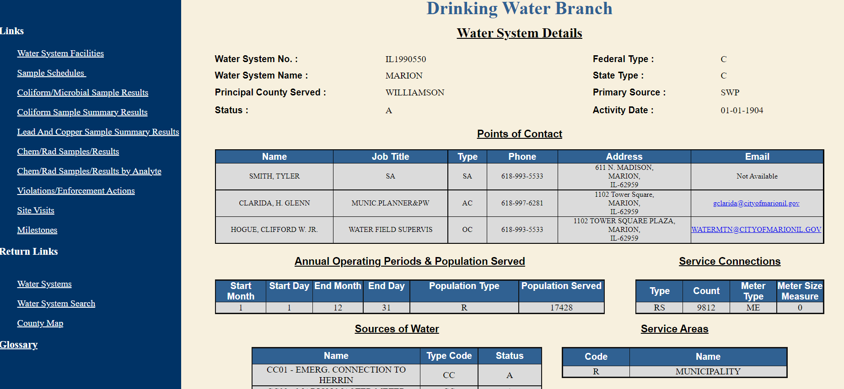

Slide 13
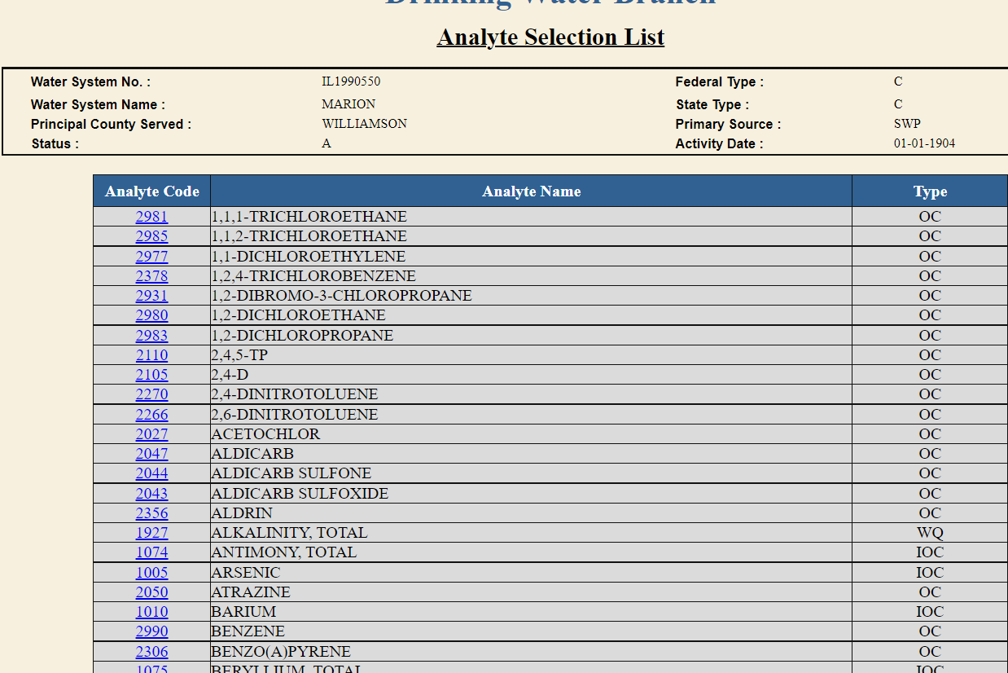
Click on Chem/Rad Sample Results by Analyte, it will take you to an alphabetic list where you will click on the one you want

Slide 14
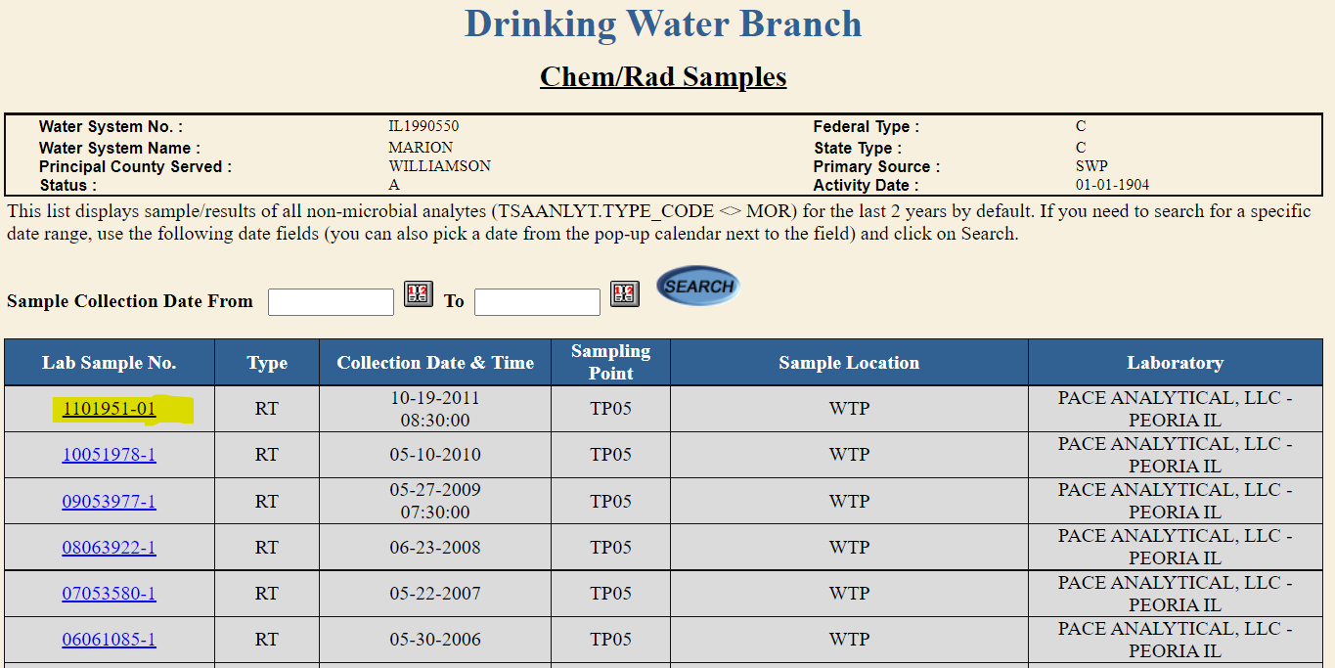
Click on the underlined blue 4-digit analyte code and it will take you to the list of lab sample IDs.

Slide 15
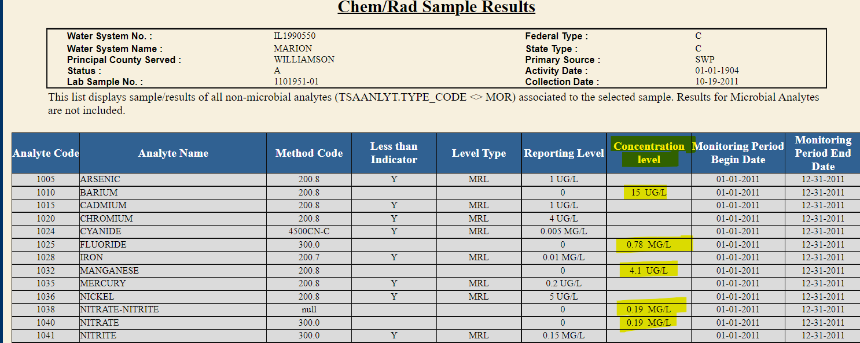
Click on the lab ID and It will show you all the results submitted for that sample ID. If the concentration column is blank that means it was NOT DETECTED

Slide 17
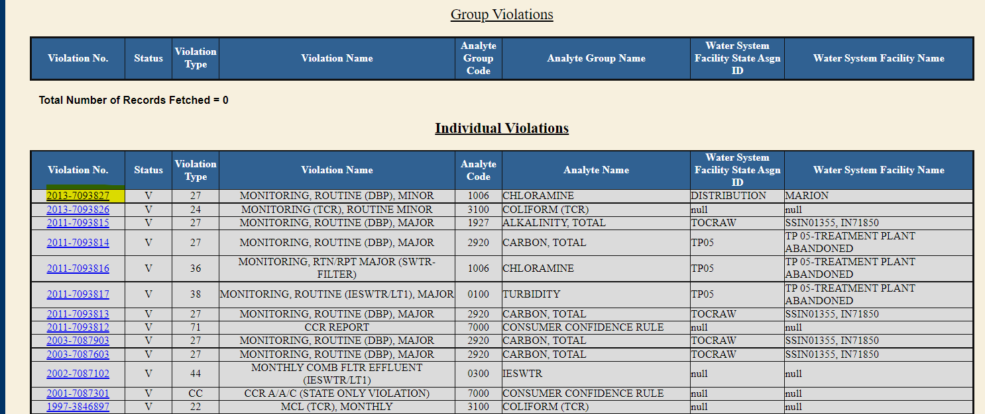
On the violation page you can click on the blue underlined # and it will take you deeper into the violation

Slide 18
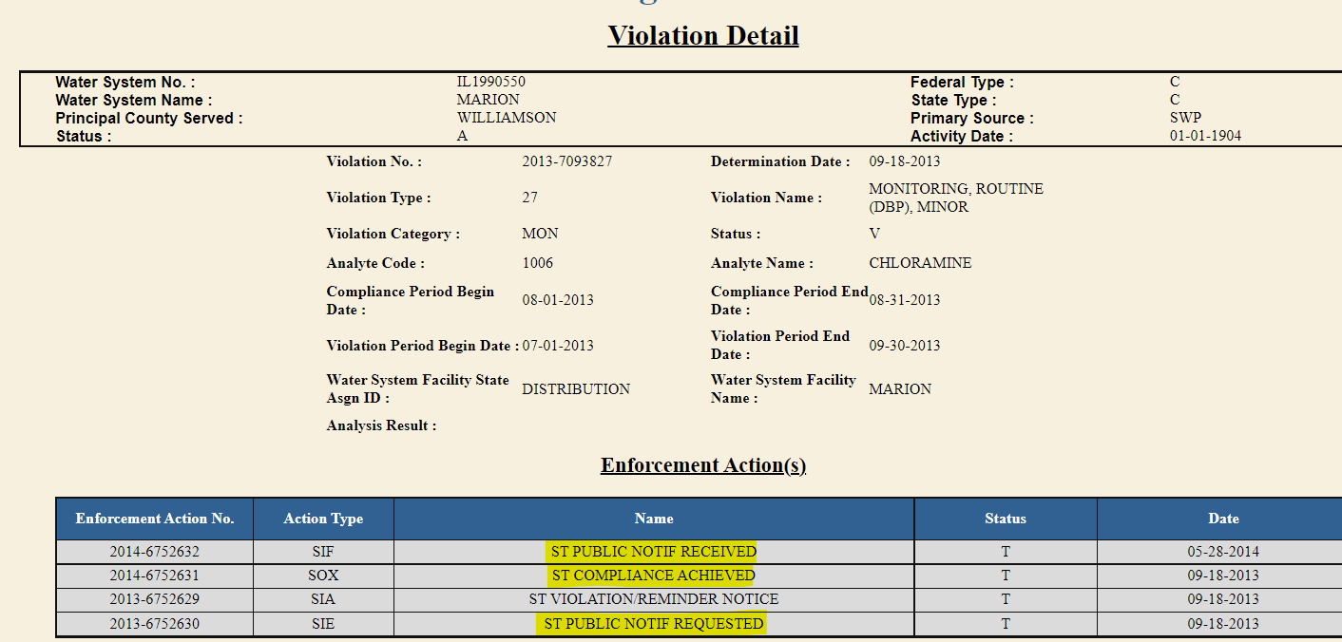

Slide 19
Operator Certification
  You need to log into the Operator Certification Database to make sure that your mailing address is up to date otherwise you may not get your renewal application.
  Also review and update your email address, if necessary, the Illinois EPA is sending certain notifications by email, and this is expected to increase in the future.
http://dataservices.epa.illinois.gov/operatorcertification/OpCertLogin.aspx

Slide 20
Wastewater Operator Certification
CLASS 3 and CLASS 4 Certificates of Technical Competency issued in 2019 or earlier expired on July 1, 2022
  To restore your expired Certificate, you must return a competed renewal application form along documentation of the minimum number of renewal training credit hours for your level of certification.
  If you are currently employed as the Chief Wastewater Operator and your certificate is expired your facility must designate a new properly certified Chief Operator. (form available on IEPA website)
  The renewal application form must be requested from Illinois EPA by emailing EPA.OperatorCertification@illinois.gov

Slide 21
Wastewater Operator Certification
  CLASS 1 and CLASS 2 operators are required to obtain 30 hours of training between July 1, 2020, and June 30, 2023.
      Minimum of 20 hours must be related to technical aspects of wastewater treatment and operations
      You will be required to submit proof of training with the renewal application in 2023. According to the Illinois EPA the renewal applications will be mailed to the address in the operator certification database by April 1, 2023.

Slide 22
Wastewater Operator Certification
  CLASS K and CLASS R Certificates of Technical Competency issued 2019 or earlier will expire on July 1, 2024.
  By January 31, 2023, Class K and Class R operators who intend to retest must submit an Examination Request for Industrial Wastewater Operator Re-certification.
  This form will enable the IEPA to determine the examination dates and locations for recertification
The Industrial operators who complete the Exam request form will be notified of upcoming examination dates and locations once they have been determined.

Slide 23
Wastewater Operator Certification
  CLASS K and CLASS R Certificates of Technical Competency issued 2019 or earlier will expire on July 1, 2024.
  If you are no longer working at the facility that you were certified under and do not wish to renew, notify the Illinois EPA at
  EPA.OperatorCertification@illinois.gov
  In the subject line of the email put
  “Cancel my K/R Certificate”

Slide 24
Important Links to keep handy
Illinois Rural Water Assn. https://www.ilrwa.org/index.htm
Illinois EPA https://www2.illinois.gov/epa/Pages/default.aspx
Drinking Water Watch https://water.epa.state.il.us/dww/index.jsp
Operator Certification Database
http://dataservices.epa.illinois.gov/operatorcertification/OpCertLogin.aspx
Small Water System Operators https://wateroperator.org/
US EPA https://www.epa.gov/ground-water-and-drinking-water
ASDWA https://www.asdwa.org/

Slide 25
Contact Information
  Hours: Monday – Thursday AM
  Email: reed@ilrwa.org
  Cell Phone 217-561-8376
  Office Phone 217-287-2115

